Slide 1


Social Buzz
Top 5 Categories.

Slide 2


Today's agenda
Project recap
Problem
The Analytics team
Process
Insights
Summary

Slide 3

Social Buzz is a fast growing technology unicorn that need to adapt quickly to its’s goal scale.
Accenture has begun a 3 month POC focusing on these tasks:
An audit of Social Buzz’s big data practice
Recommendations for a successful IPO
Analysis to find Social Buzz’s top 5 most popular categories of content
Project Recap

Slide 4

Problem
Over 100,000 posts per day
36,500,00 pieces of content per year!
But how to capitalize on it when there is so much?
Analysis to find Social Buzz’s top most popular categories of content

Slide 5



Andrew Fleming
Chief Technical Architect
The Analytics team
Marcus Rompton
Senior Principle
{Myself}
Data Analyst

Slide 6
Process
1
Data Understanding
t
2
Data Cleaning
3
Data Modelling
4
Data Analysis
5
Uncover Insights

Slide 7

Insights
16
UNIQUE CATEGORIES
3535
REACTIONS TO “TENNIS” POSTS
April and November
MONTH WITH MOST POSTS

Slide 8
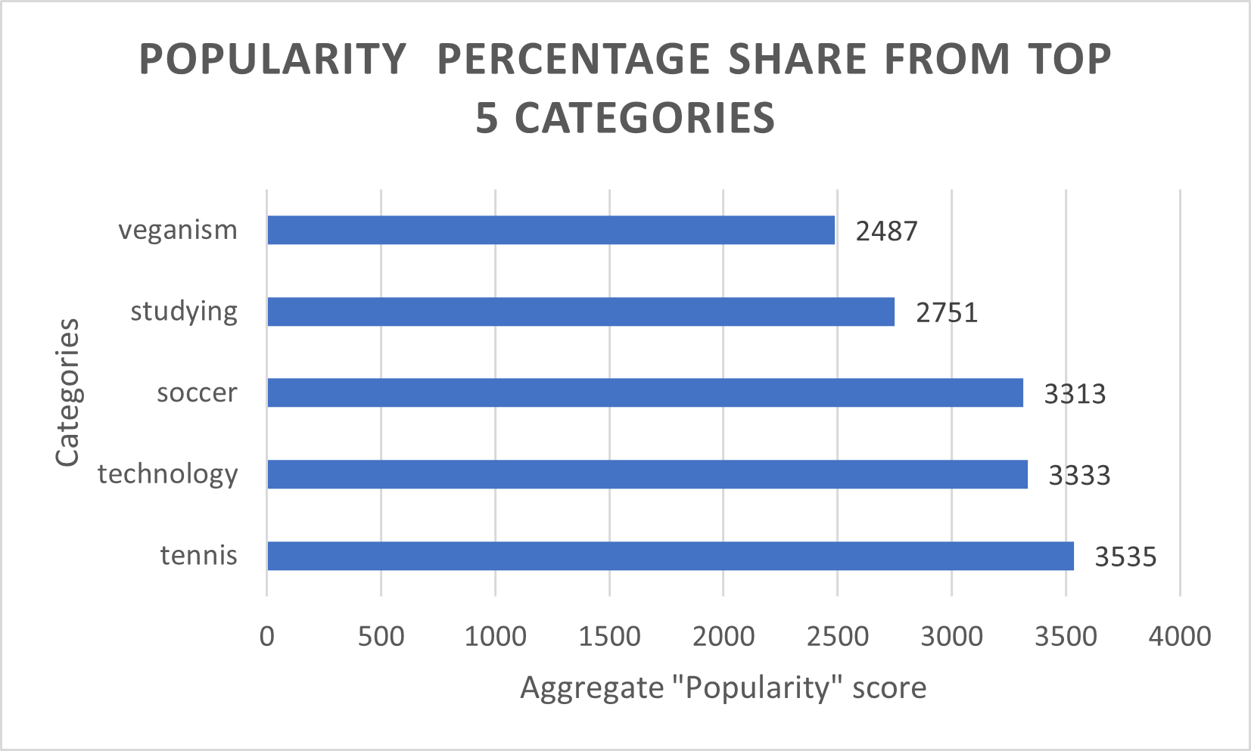

Slide 9
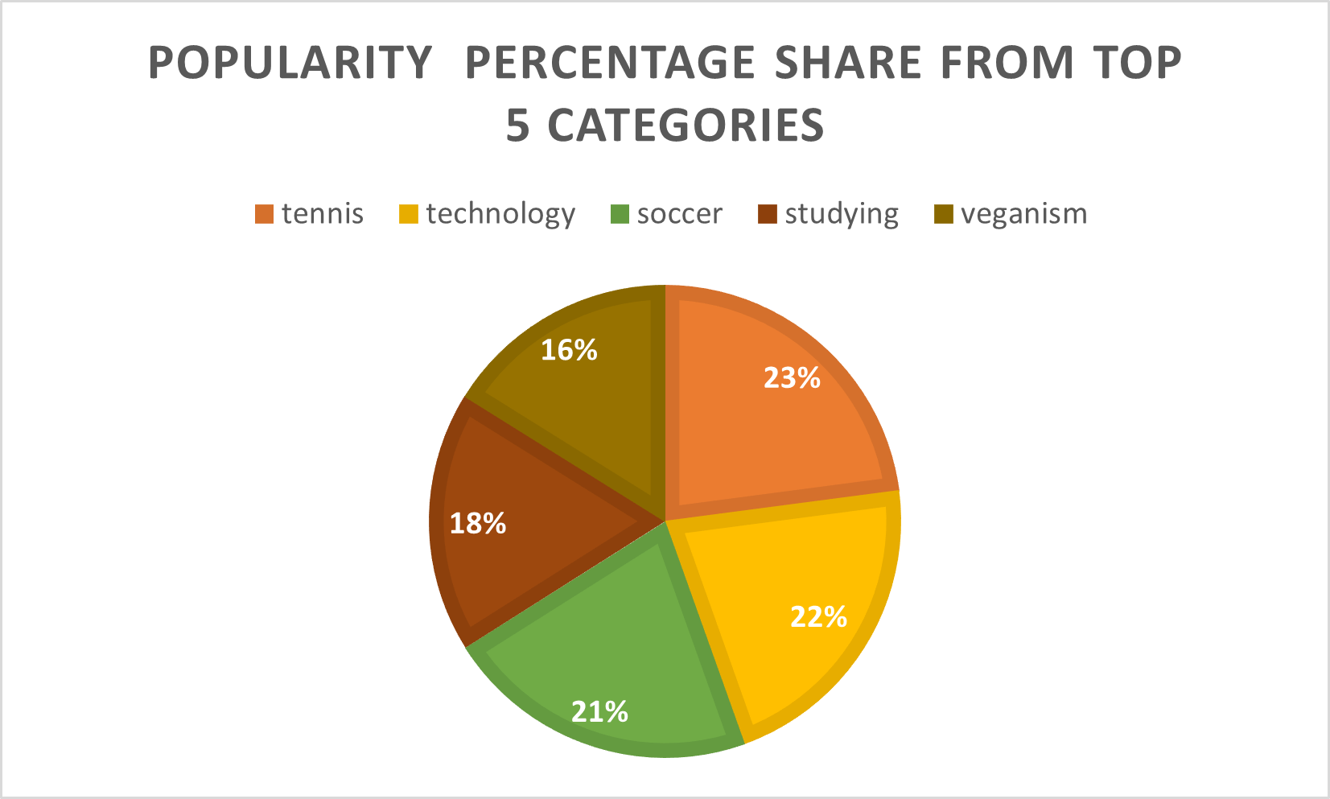

Slide 10

Analysis
Tennis and technology are the two most popular categories of content, showing that people enjoy “games” and “computing” content the most.
INSIGHT
Commitment is a recurring theme across the top five categories, with “Tennis" ranking the highest. This suggests a potential interest within your user base. Leveraging this insight, you could design a campaign and collaborate with brands that promote commitment to enhance user engagement.
Next STEPS
This ad-hoc analysis is insightful, but it’s time to take this analysis into large scale production for real-time understanding of your business. We can show you how to do this.
Summary

Slide 11
Thank you!
ANY QUESTIONS?

